Slide 1
Java Presistance

Slide 2
Overview
Mapping Java objects to database tables and vice versa is called Object-relational mapping (ORM). The Java Persistence API (JPA) is one possible approach to ORM
JPA is a specification and several implementations are available. Popular implementations are Hibernate, EclipseLink and Apache OpenJPA
JPA defines a SQL-like Query language for static and dynamic queries

Slide 3
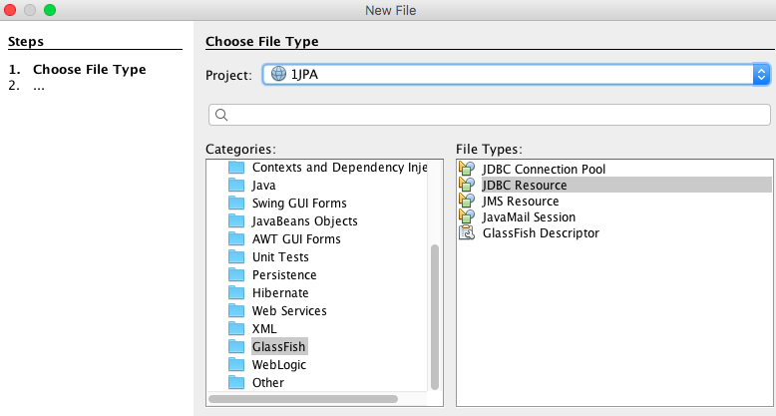
Create JDBC Resource

Slide 4
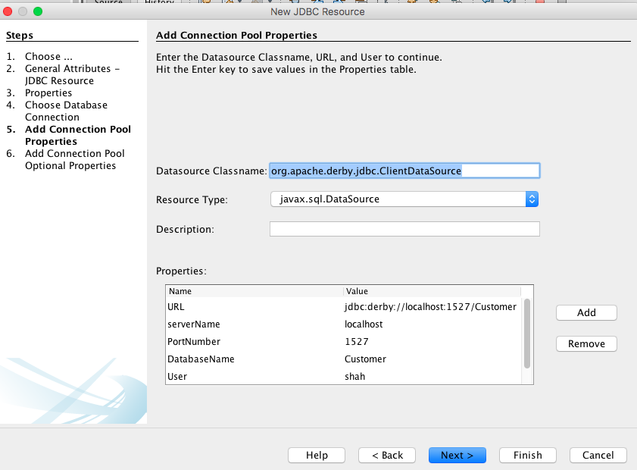
Create JDBC Resource

Slide 5
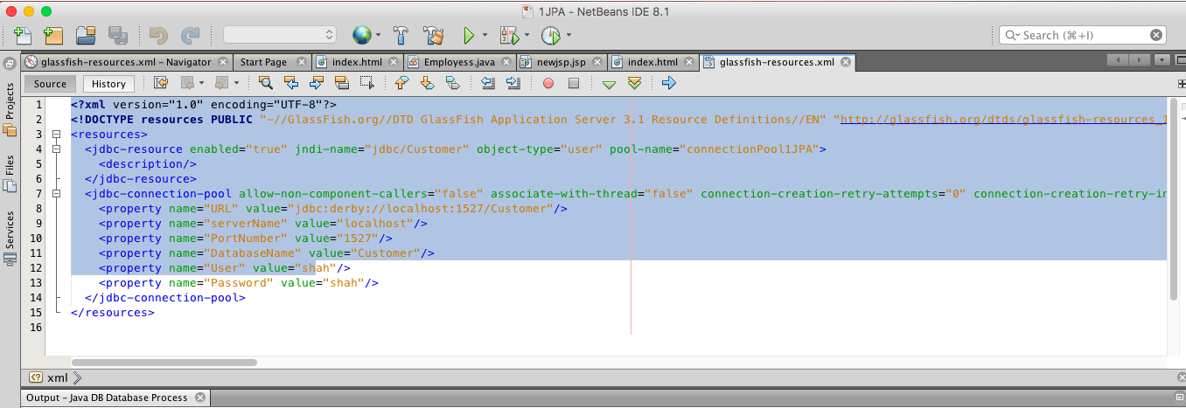

Slide 6
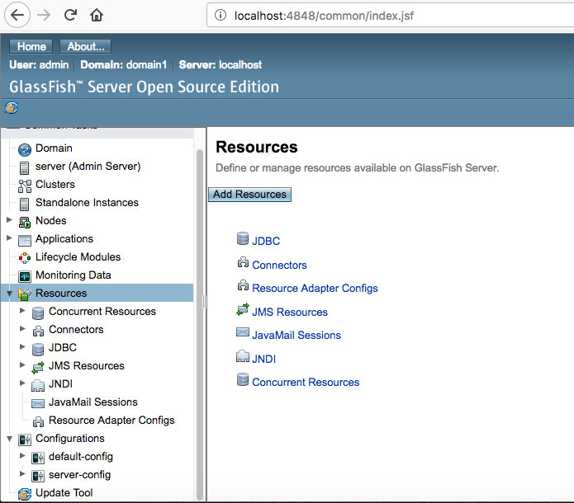

Slide 7
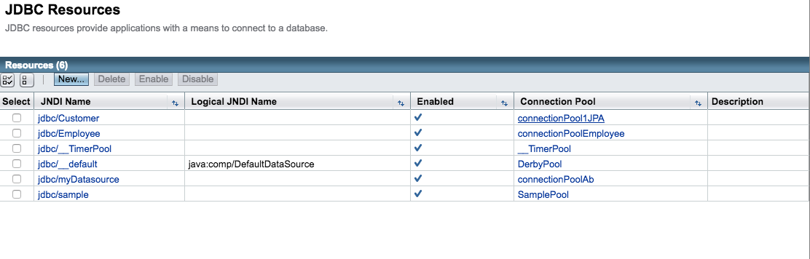

Slide 8
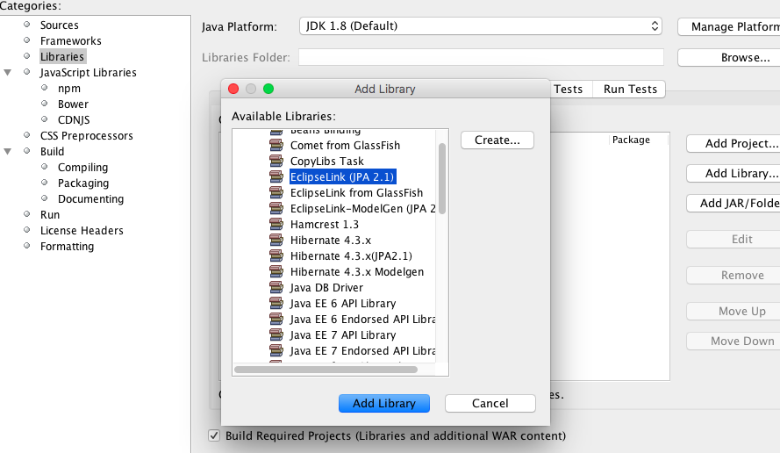
Add EclipseLink Library

Slide 9
Persistence API
The Java Persistence API (JPA) was introduced as part of the Java EE 5 platform
Its goal is to facilitate data acquisition from relational databases without the complexity of numerous sql statements
The idea is to use an object oriented approach to data storage
Data is handled without the need to create deployment descriptors.
  Instead annotations are used which are read by the container.

Slide 10
Java Transaction API-JTA
The Java Transaction API (JTA) is part of the JEE platform.
The API gives you the ability to perform distributed transactions, that is, an application can use the API to perform transactions on more than one data store in the network at the same time.
But to do this efficiently, it helps to have another component operating in the application server: a JEE transaction manager.
A transaction manager helps to efficiently schedule and execute the potentially large number of transactions coming in through the application server.

Slide 11
Persistence API-Entities
Entity
  A table in a database.
  An Entity is represented by a class
  Instance of entity corresponds to a row in the database.
  A number of rules cover the implementation of an entity class.
  Note: The database is sometimes referred as: Data Source or Data Store

Slide 12
Persistence API-Entity Relationships
Relationships are the same as relationships between tables in a database:
  One-To-One:
    Each instance of the entity (row) is related to single instance of another entity (to a single row of another table).
  One-To-Many:
    An entity instance can be related to more than one instance of another entity. But an instance of the other Entity can only relate to one instance of the first.

Slide 13
Persistence API-Entity Relationships
  Many-To-One:
    Multiple instances (rows) of an Entity can be related to one instance of another Entity. But an instance of the other Entity can relate to only one instance of the first Entity.
  Many-To-Many:
    An instance of one Entity relates to many instances of another Entity and vice versa.
For every relationship there is an owning side and inverse side.
  The relationship can be unidirectional –it has only an owning side.
  Or, bidirectional – it ha s both an owning side and an inverse side.

Slide 14
Persistence API-Entity Class
Entity Class
  The class has instance variables
  The class has accessor and mutator methods that follow the Java Beans convention for naming the methods.
  The persistent state can be accessed either through the instance variables or through the getter methods (accessors).

Slide 15
Persistence API-Entity Class
The annotations are defined in javax.persistence, so you'll need to import that package.
Annotations are handled by package javax.persistence
  Fields annotated with Transient are not persisted (saved).
  Annotations apply to other parts of the program i.e.
    The class needs to be annotated with the @Entity annotation.
    The type of relationship needs to be annotated with @OneToOne for example.
    Other annotations apply to different parts of the class.

Slide 16
Persistence API-Entity Class
Every Entity must have a unique primary key field that enables clients to locate instances (rows) of an Entity.
  Primary Keys can be:
    Simple (consisting of a single field) or
    Composite (consting of one or moret persistent field and or properties)
      Composite primary keys are represented by a primary key class.

Slide 17
Persistence API-Entity Class
Entities support:
  Inheritance. An Entity class can inherit a non Entity class and a non Entity class can inherit an Entity class.
  Polymorphism.
    You can have an abstract Entity class and subclasses of the abstract Entity class that implement parts of the abstract class in different ways each.
  Association (using another class by instantiating an object of that class).

Slide 18
Persistence API-Entity Management
There is an Entity Manager object represented by an instance of: javax.persistence.EntityManager
  Each manager object is associated with a persistent context (scope).
  Each manager object:
    Removes persistent entity instances.
    Finds Entities by using the primary key.
    Allows queries to be run on Entities.

Slide 19
Persistence API-Persistence Units
Persistence Unit defines all Entity classes that are managed by EntityManager instances within an application.
  A name should be provided to describe the Persistence Unit in your application.
  A Persistence Unit is defined in the persistence.xml configuration file.
  Location of the file within the application varies depending dependent on if the client is a client application or a web application.
    The IDE will place it in the proper directory.

Slide 20
Persistence API-Entity Class
Assume you have a CUSTOMER table, whose schema is represented by the table in the next slide.

Slide 21
Customer Table Example
NAME | PK? | TYPE | NULL?
CUST_ID | Y | INTEGER | NOT NULL
FIRST_NAME |  | VARCHAR(50) | NOT NULL
LAST_NAME |  | VARCHAR(50)
STREET |  | VARCHAR(50)
CITY |  | VARCHAR(25)
ZIP_CODE |  | VARCHAR(10) | NOT NULL
LAST_UPDATED_TIME |  | TIMESTAMP | NOT NULL

Slide 22

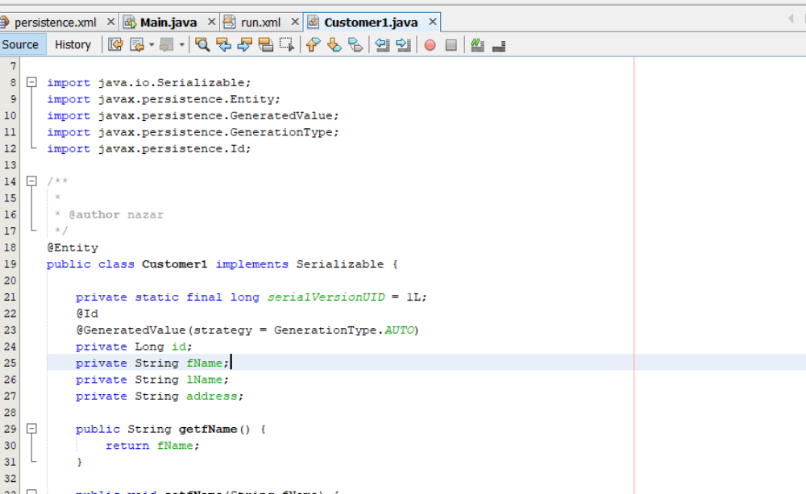

Slide 23
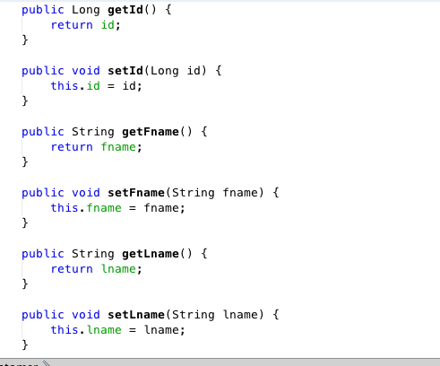
Customer Entity Class

Slide 24
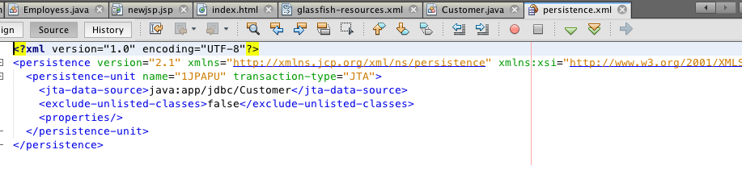
Persistence.xml

Slide 25
Customer Entity Class
The Customer entity needs to know how to map the attributes (or properties) to the CUSTOMER table.
  Through JPA annotations. Let us use Field persistence:

Slide 26
Customer Entity Class
import javax.persistence.*;
import java.io.Serializable;
import java.util.Date;
@Entity(name = "CUSTOMER") //Name of the entity
public class Customer implements Serializable {
@Id //signifies the primary key
@GeneratedValue(strategy = GenerationType.AUTO) private long custId;
// above two annotations define the field customer Id as a primary key.
//@GeneratedValue signifies a strategy to assign a unique value to your identity fields automatically.
//The types of strategies available are IDENTITY, SEQUENCE, and AUTO etc

Slide 27
Customer Entity Class-A class that inserts a record
EntityManagerFactory entityManagerFactory = Persistence.createEntityManagerFactory(”JPAContext");
EntityManager em = entityManagerFactory.createEntityManager(); EntityTransaction userTransaction = em.getTransaction(); userTransaction.begin();
Customer customer = new Customer();
customer.setFName(”David");
customer.setName(”Bell");

Slide 28
Customer Entity Class-Inserts a record
em.persist(customer);
em.getTransaction().commit();
em.close();
entityManagerFactory.close();
}

Slide 29
Customer Entity Class-A class that inserts a record
EntityManagerFactory is a factory for creating an EntityManager. EntityManagerFactory should be cached and should ideally be called once for each persistence unit name in the whole application.
EntityManager manages entities; it is responsible for their addition, updating, and deletion.
The transaction is committed after inserting record

Slide 30
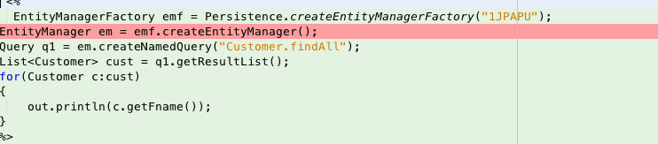
Retrieving Records

Slide 31
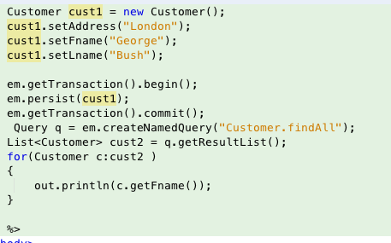
Adding Record

Slide 32
Finding Customers
EntityManagerFactory emf=Persistence.createEntityManagerFactory(“JPAPU");
EntityManager em=emf.createEntityManager();
StudentEntity s=em.find(Customer.class,101);

Slide 33
Update
EntityManagerFactory emf=Persistence.createEntityManagerFactory(“JPAPU");
EntityManager em=emf.createEntityManager();
StudentEntity s=em.find(Customer.class,102);
s.setAddress( “Address”)

Slide 34
Remove Entity
EntityManagerFactory emf=Persistence.createEntityManagerFactory(“JPAPU");
EntityManager em=emf.createEntityManager();
em.remove(s);
em.getTransaction().commit();
emf.close();
em.close();

